Slide 1
Exploring the Arrondissements of Paris to Create a Travel Itinerary
Coursera Applied Data Science Capstone Project

Slide 2
introduction
Paris, the global center of finance, fashion, arts, science, and gastronomy, and history, can be very intimidating and overwhelming on a first visit.
It is advantageous to prepare a travel itinerary that prioritizes must-do activities and must-see sights in an efficient way but also have enough flexibility for exploration so visitors can rest assured they are not missing out on a special experience.
This project aims to create an efficient itinerary that saves time, includes must-see attractions, and make suggestions for what to do, see, and eat, taking into account distance, time, and location utilizing Foursquare location data.

Slide 3
Data acquisition & Cleaning
The following sources were used in this project
Wikipedia (for arrondissement information)
Google Reviews, Architectural Digest, Lonely Planet (for top Paris landmarks)
Carto (for Paris location data to map out boundaries of arrondissement)
Foursquare (for venue information data and location)
The data was gathered using web-scraping, making calls to the Foursquare API, and downloading geojson files.
Minor data cleansing was done including adding simplified arrondissement column names, getting rid of duplicates, and deleting unnecessary columns.

Slide 4
Exploratory data analysis
The majority of our exploratory data analysis focused on using longitude and latitude information to make maps and other visuals in order to better understand where landmarks and other points of interests were located
We utilized choropleth maps, dot maps, and content tables

Slide 5
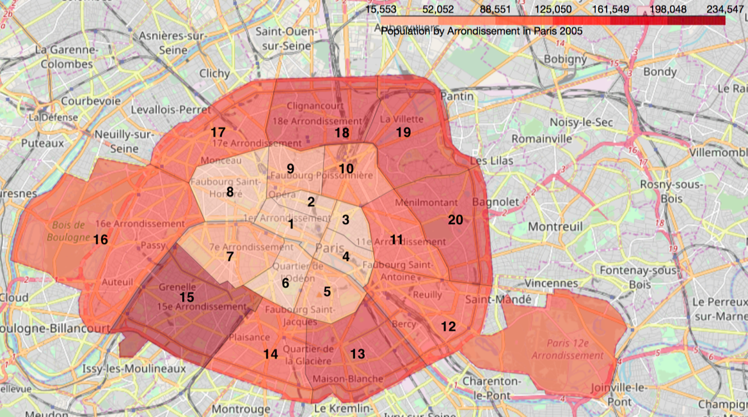
Choropleth Map of Paris
The first exploratory data analysis performed a choropleth and boundary map of Paris to get a visual of how and where the arrondissements are located.
Then, we used 2005 Population information to shade each arrondissement, where darker red means higher population density and lighter red means lower population density.
Notice the arrondissements are ordered in a clockwise fashion starting from the center and spiraling outward

Slide 6
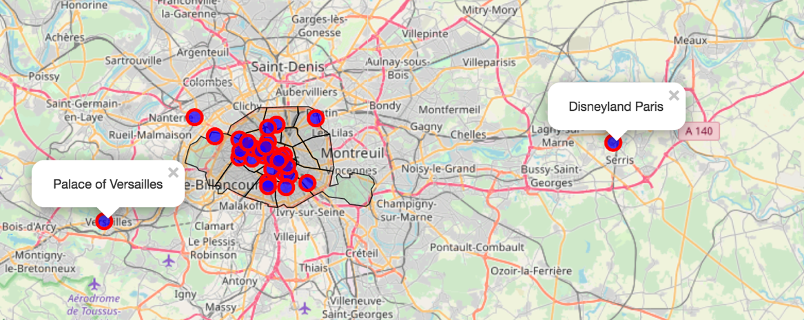
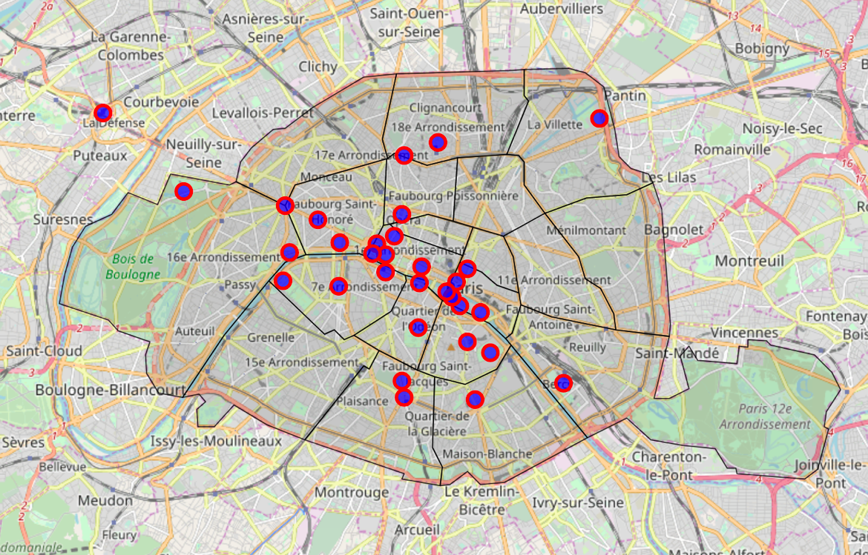
Major Landmarks
I created a map that showed the top landmarks of Paris according to users on Google, Lonely Planet, and other travel websites.

Slide 7
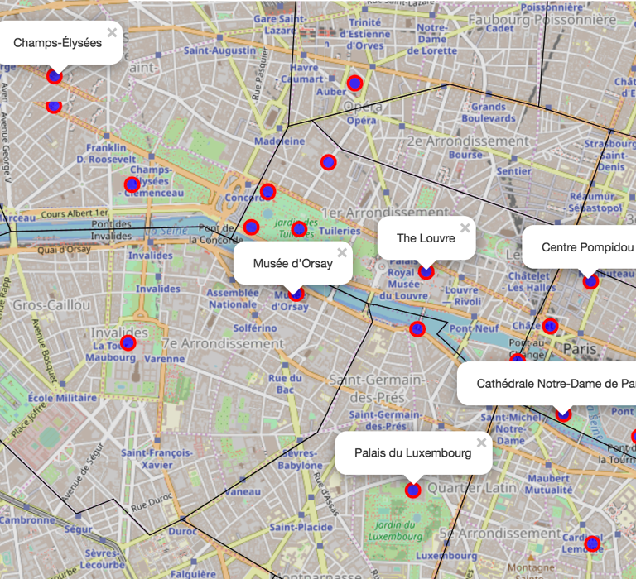
Up close view
This close up map shows in detail the location of a few major landmarks, including the Louvre, the Champs-Élysées, and the Musée d’Orsay.

Slide 8
Clustering Venues using Foursquare Data
We downloaded venues data from Foursquare and clustered the venues and venue category by arrondissement. We created the table below which shows the top 10 most common venues per arrondissement.

Slide 9
Hotels
The first thing people purchase after their plane ticket to Paris is likely hotel accommodations. Here is a map that features the lodging options along the famous boulevard, the Champs-Élysées. Want an up-close view of the Eiffel Tower and the Seine River? How about checking into the luxurious Shangri-La Hotel Paris or the Hotel Passy Eiffel?

Slide 10
Hotels
The first thing people purchase after their plane ticket to Paris is likely hotel accommodations. Here is a map that features the lodging options along the famous boulevard, the Champs-Élysées. Want an up-close view of the Eiffel Tower and the Seine River? How about checking into the luxurious Shangri-La Hotel Paris or the Hotel Passy Eiffel?

Slide 11
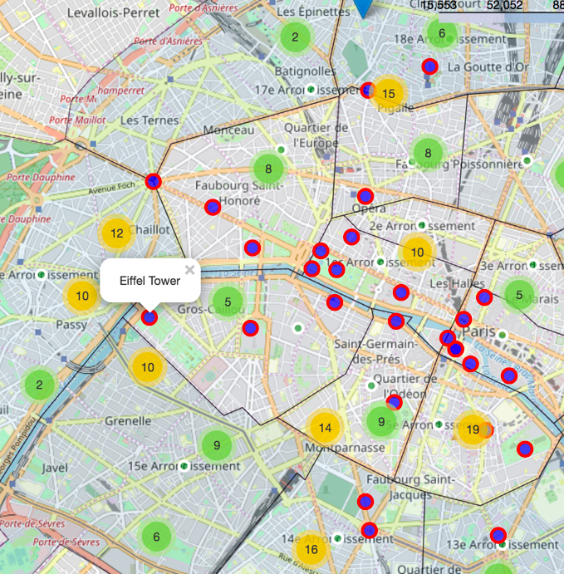
French Cuisine
If you were near the Eiffel Tower and are in the mood for French food, you have over 30 options around you within a short walk of the Tower. Besides the two restaurants that are within the Eiffel Tower complex, you can also head over to Le Casse Noix or Pottoka.

Slide 12
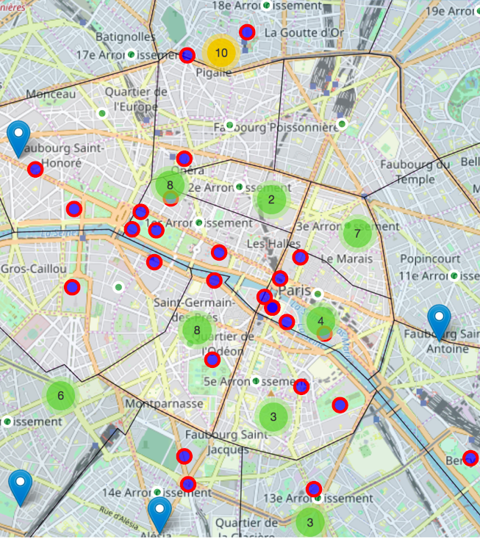
Dessert
No trip to Paris is complete without a visit(s) to a local dessert shop for a crepe, a soufflé, or another delish treat. Fortunately, Paris has no shortage of sweet shops all around the city, perfect for a short pitstop before exploring the next museum or public plaza.
The green clusters are all dessert options around the city

Slide 13
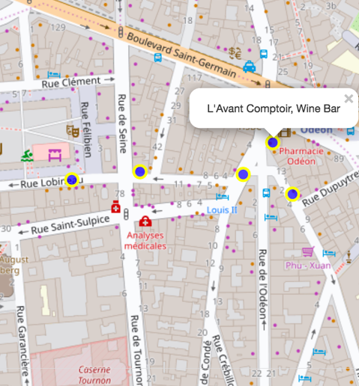
Drinks and Nightlife
The Latin Quarter in the 6th Arrondissement is famous for its nightlife and bars. If you’re hoping to participate in a Paris bar crawl, this is the place to be.

Slide 14
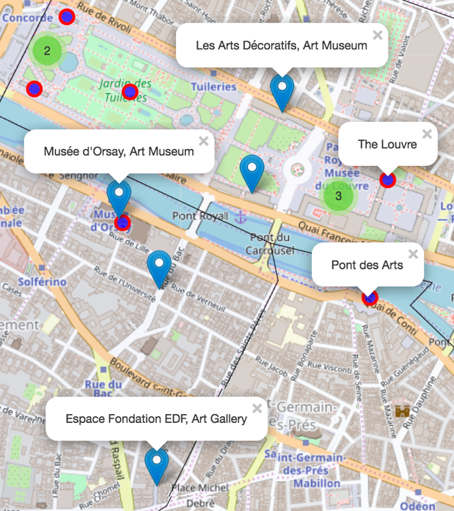
Museums
For museum lovers, Paris is the mecca. The hardest part is deciding which museum to visit and for how long. Museums featured in our data gathering range from art museums, galleries, and exhibits to history and science museums. Below is a map featuring some museums in blue pin/clusters among other famous landmarks in blue/red dots.

Slide 15
Outdoor Sights
Paris is well known for its city planning, featuring green spaces and lookouts around the city, including beautiful gardens, parks, and public plazas. Below is a detailed look in the areas surrounding the famous Luxembourg Gardens, in the 5th, 6th, and 7th Arrondissements

Slide 16
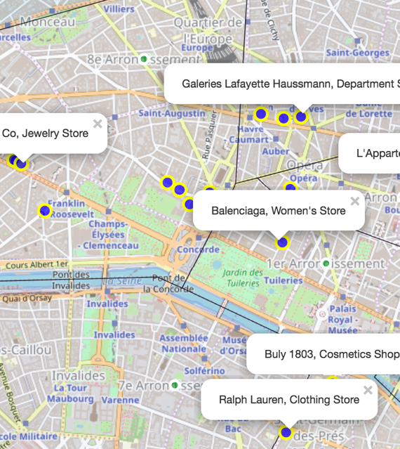
Shopping
Paris is the fashion capital of the world and there is no shortage of boutiques, malls, and specialty shops for even the most prolific shopaholic. The 8th Arrondissement features many designer brands and other luxury stores selling clothes, handbags, watches, and jewelry.

Slide 17
Day 1
Head over to the 7th Arrondissement for a full day of exploring! Up first, the famous Eiffel Tower, along the River Seine. You can choose to make your way to the top or take pictures around the surrounding garden and plaza.
Have yourself a picnic on the green gardens surrounding the Eiffel Tower. You can visit the nearby Marché de Saxe Farmers Market to pick up farm grown picnic food.
Sit down for some afternoon tea at the nearby Aux Cerises Tea Room.
Learn more about France’s military history by visiting Les Invalides complex, which features museums and monuments.
There are many local French restaurants to try out, including more than 30 within walking distance from the Eiffel Tower. Some of the closest restaurants include Le Jules Verne and Restaurant 58 Tour Eiffel.
After dinner, stroll around the Seine as you wait for the Eiffel Tower to light up in the night sky. Perhaps stop by for dessert at Boulangerie Desgranges across the river.

Slide 18
Day 2
Start your day at the west end of the Champs-Élysées at the famous landmark, the Arc de Triomphe. Built 1836 to honor those who died during the French Revolution and the Napoleonic Wars, this is perhaps Paris’s most well-known landmark after the Eiffel Tower.
Stroll down the most famous street in the world, the Champs-Élysées. Browse the many boutiques and luxury stores that line its sides as you head east.
Make a stop at the The Grand Palais and admire its architecture.
Stop by the Ladurée Paris Royale bakery for a quick lunch or picnic items. Looking for something more substantial? Le Dalí is a nearby French restaurant.
Enjoy the weather and the slow Parisian lifestyle by grabbing a bench at the Tuileries Garden for some people watching.
Cross the river to the Musée d’Orsay, where you can spend the late afternoon among famous French artworks.
For dinner, the French restaurants L'Atelier de Joël Robuchon or Guy Savoy are close by. The bistro L'Avant-Comptoir des Cochons is also close by.
For a nightcap, Prescription Cocktail Club and Chez Nous wine bar are not too far away.

Slide 19
Day 3
Go early to Le Lourve to beat the crowds and get the museum to yourself. Be sure to say hi to the Mona Lisa.
Sample some French cheese at Fromagerie Barthélemy and pick up some items for a picnic lunch at the Palais du Luxembourg and its surrounding gardens.
The Pantheon is a short walk away from the Garden and is a mausoleum containing the remains of distinguished French citizens.
Craving some seafood? L'Avant Comptoir de la Mer has you covered. How about some Italian? Head over to Oenosteria.
End the night by visiting the Latin Quarters for some drinks at a local bar. Crowd favorites include Castor Club or wine bar L'Avant Comptoir.
Alternatively, enjoy an indie film at La Filmothèque du Quartier Latin or a performance at the Odéon – Théâtre de l'Europe.

Slide 20
Day 4
Begin the day along the Seine at Cathédrale Notre-Dame de Paris, the famous cathedral known for its architecture.
If you’re still not tired of museums, the Centre Pompidou is a modern museum with interesting architecture.
Other close by landmarks include the small islands, Île Saint-Louis and Île de la Cité, as well as La Conciergerie and Saint-Jacques Tower
Ready for another picnic by the Seine? Visit Fromagerie Laurent Dubois for food. Nearby restaurants include Le Petit Châtelet, Comme chai Toi, or Anahuacalli.
Make the trek across the Seine to catch a performance in the Bastille neighborhood. Venues include Opéra Bastille for opera or Café de la Danse for modern music.
Food options near the venue include Gaspard de la Nuit (French), Nove (Italian), and Café Ginger (Asian fusion/Vegan) for dinner.
La Moustache Blanche and Berliner Wunderbar are good options for drinks.

Slide 21
Day 5
Make a day trip trek out to the Palace of Versailles and explore its grand architecture and lush gardens.
Disneyland Paris is another option to the far east of the city.
This can also be a catch up day to do any activities you weren’t able to squeeze in during the previous few days or to wander around Paris and find a new adventure!

Slide 22
Conclusion
The itinerary I created made many assumptions on time, money, weather, and duration of stay.
I want to emphasize that itineraries are just general guild lines and travelers can choose to deviate if, say, they find the Louvre to be only an hour visit or that reading in the Jardin de Luxembourg should be an all-day activity accompanied by French cheese and wine.
I learned a lot about scraping data, visualizing it, and making maps that can provide guidance for creating a travel plan.
I hope to further explore venue tips, ratings, and distance between venues.
I can’t wait for my first trip to Paris!

